Slide 1
QUESTIONS
What are the definitions of jeopardy and destruction or adverse modification of critical habitat?
How did the 2008 biop find J/DAM?
How will the next J/DAM analysis be different?
Can compliance with RPA avoid jeopardy without achieving recovery?

Slide 2
50 CFR 402.02, DEFINITIONS
Jeopardize the continued existence of - reduce appreciably the likelihood of both the survival and recovery of a listed species.

Slide 3
50 CFR 402.02, DEFINITIONS
Destruction or adverse modification means a direct or indirect alteration that appreciably diminishes the value of critical habitat for the conservation of a listed species. Such alterations may include, but are not limited to, those that alter the physical or biological features essential to the conservation of a species or that preclude or significantly delay development of such features. (81 FR 7214; Feb 11, 2016)

Slide 4
2008 Biop Analytical Approach
Identify the action
Evaluate current status of the listed species with respect to biological requirements indicative of survival & recovery, & PCEs designated CH
Evaluate the relevance of the EB to the species’ BRs & current status, & current status of CH
Determine whether the proposed action reduces the abundance, reproduction, or distribution of the species, or negatively alters any PCEs of designated CH
Determine & evaluate any CE
Evaluate whether the effects of the proposed action, taken together with CEs & effects within the EB, can be expected, directly or indirectly, to reduce appreciably the likelihood of both the survival & recovery of the affected species, or are likely to destroy or adversely modify critical habitat
“The jeopardy standard is survival with an adequate potential for recovery.”

Slide 5
2008 Biop Conclusions Exec Summary
“The Proposed Action (PA) would jeopardize the continued existence of UWR Chinook salmon & UWR steelhead, & would destroy or adversely modify their critical habitat because it does not adequately address adverse effects of the dams, revetments and hatcheries on listed fish & their habitat, factors that are suppressing the viability of both species & are contributing to the high risk of extinction for UWR Chinook.

Slide 6
2008 Biop Conclusions Proposed Action
1. “The PA would continue to prevent safe access for UWR Chinook salmon to their historical habitat above the dams, & would continue to kill & injure large numbers of individual juvenile fish migrating downstream past the dams.”
2. “The proposed operation of the Willamette Project would continue to reduce the extent, quality, & inundation frequency of riparian & floodplain forests in the Middle Fork Willamette subbasin downstream of Dexter & Fall Creek dams.”

Slide 7
2008 Biop Conclusions Proposed Action
3. “Significant improvements to the status of the Middle Fork spring Chinook population are necessary in order to improve the viability of the ESU as a whole . . . Re-establishing natural production in historical habitats above Project dams is of critical importance.”
4. “The PA would result in continued degradation of complex habitat in the mainstem Willamette River above Willamette Falls, likely reducing the carrying capacity of this habitat for rearing juvenile fish, thereby reducing the number of UWR Chinook salmon & UWR steelhead that can be produced in this presently degraded habitat.”

Slide 8
2008 Biop Conclusions UWR Chinook
Under the PA, many of the significant adverse effects on the species & its critical habitat in the freshwater portion of the action area, which contributed to its current high risk of extinction, will continue without providing needed measures including effective passage, or adequate temperature control. In addition, the PA will continue the adverse effects on the functioning of PCEs that have impaired the ability of CH to serve its conservation role for the species.
Therefore, NMFS concludes that the proposed operation of the Willamette Project and associated hatchery mitigation program are likely to jeopardize the continued existence of this ESU & to destroy or adversely modify its designated critical habitat.

Slide 9
2008 Biop Conclusions UWR Steelhead
Limiting factors & effects of the PA on the species and its habitat are similar to those described above for UWR Chinook salmon. In this case, two of the four populations occupy watersheds where habitat has been significantly degraded by Willamette Project operations. The PA will continue to prevent access to some of the important areas used historically for spawning, incubation, & larval growth & development & will impair water quantity & quality. The PA will also continue hatchery practices that represent substantial risk to the development of self-sustaining populations. The improvements implemented under the PA will not provide needed measures including effective passage, or adequate temperature control.
Therefore, NMFS concludes that the Proposed Action is likely to jeopardize the continued existence of this DPS & to destroy or adversely modify its designated critical habitat.

Slide 10
2008 Biop Conclusions Other species
Not jeopardy, no destruction or adverse modification of CH:
LCR steelhead, Chinook salmon, coho salmon
CR chum salmon
MCR steelhead
SRB steelhead
SR spring/summer Chinook, fall Chinook, & sockeye salmon
UCR steelhead and Chinook salmon
SRKW

Slide 11
HOW WILL THE NEXT J/DAM ANALYSIS BE DIFFERENT?
Slightly different analytical approach
Significant new information on
EB
Status of species and CH
Effects of proposed action
CE
Climate Change
Litigation

Slide 12
Current Analytical Approach
Identify the rangewide status of the species & CH expected to be adversely affected by the proposed action.
Describe the EB in the action area.
Analyze the effects of the proposed action on both species & their habitat using an “exposure-response-risk” approach.
Describe any CEs in the action area.
Integrate & synthesize the above factors by: (1) Reviewing the status of the species & CH; & (2) adding the effects of the action, the EB, & CE to assess the risk that the proposed action poses to species & CH.
Reach a conclusion about whether species are jeopardized or CH is adversely modified.
If necessary, suggest a RPA to the proposed action.

Slide 13
ESA Sec.4(f), RECOVERY PLANS
The Services shall develop and carry out plans to conserve listed species. Plans must include:
Site specific actions
Objective, measurable criteria
Estimates of time and cost, and intermediate steps

Slide 14
NWF v. IDAHO (9th Cir, 2008)
District court properly concluded the 2004 FCRPS biop was legally deficient because it did not adequately consider impacts on the listed species’ likelihood of recovery
NMFS’ analysis of the jeopardy standard read “recovery” entirely out of the text

Slide 15
WILD FISH CONSERVANCY (W.D. Wash, 2010)
NMFS & EPA ignored salmon & orca recovery plans NMFS said were based on “the best available science”
District court set aside the water quality standards & ordered AAs to reconsider, taking the “best science” into account

Slide 16
RECOVERY PLAN INFO USEFUL FOR A BIOP
Completed RPs include:
Objective, measurable delisting criteria
Species status relative to delisting criteria
Factors that caused species to decline & limit recovery
Site-specific actions needed for recovery, with timelines and duration (cf. delay)

Slide 17
RELATIONSHIP BETWEEN RECOVERY PLANS AND BIOPS
RPs provide the “best available info” for:
What “recovery” looks like
VSP criteria to assess whether threats to species have been addressed
Conservation value criteria to assess effects to CH

Slide 18
Broad Sense Recovery Goals e.g., Fully Functional Ecosystems
“It is our policy that the recovery of salmonid populations must achieve two goals: (1) Restore salmonid populations to the point where they no longer require the protection of the ESA, & (2) restore salmonid populations to a level that allows meaningful exercise of tribal fishing rights. We see no conflict between the statutory goals of the ESA & the federal trust responsibilities to Indian tribes. Rather, the two federal responsibilities complement one another.”

Slide 19
Broad Sense Recovery Goals Citation
Letter from Terry Garcia (Asst Sec for Oceans and Atmosphere, DOC) to Ted Strong (Exec Dir of CRITFC) (re: federal trust responsibility to the four Columbia River Treaty Tribes and the ESA (June 21, 1998).

Slide 20
Why is delay a problem?
Small pops are highly vulnerable to catastrophic events, chance demographic occurrences, inbreeding depression, & environmental variation.
Accordingly, the longer a listed species remains at depressed population levels, there is a greater likelihood that chance events will severely affect it or even wipe out its population.

Slide 21
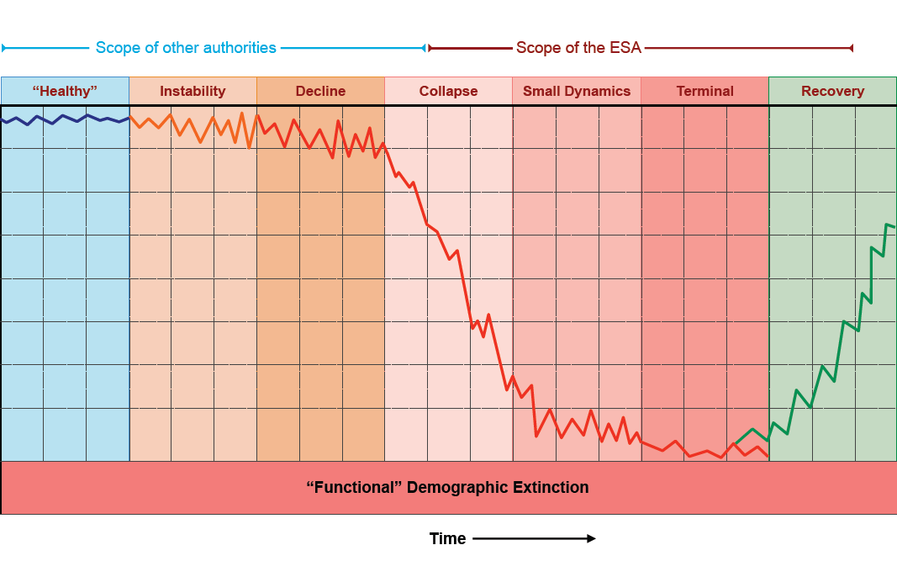
DEMOGRAPHIC EXTINCTION PROCESS

Slide 22
From: McElhany et al. 2007
Probability of Extinction | Extinction Risk (Viability) Category | Extinction Risk Category | Risk Category Score
0.00 to 0.01 | Viable Very Low | VL | 4
0.01 to 0.05 | Viable Low | L | 3
0.05 to 0.25 | Non-Viable Moderate | M | 2
0.25 to 0.60 | Non-Viable High | H | 1
0.60 to 1.00 | Non-Viable Very High | VH | 0

Slide 23
SPECIFIC WILLAMETTE RP GOALS AND DELISTING CRITERIA
Biological, VSP criteria:
>2/7 CS and >2/5 SH >3
Ave for species all pops >2.25
Core pops >3 VSP (3/4 CS, 2/2 SH)
Legacy pops >3 VSP
Pops now <3 VSP cannot decline
Underlying FFD mitigated
“Broad sense recovery” (may > delist)

Slide 24
CAN COMPLIANCE WITH AN RPA AVOID J/DAM WITHOUT ACHIEVING RECOVERY?
An RPA is not a recovery plan and must only insure the proposed action will not appreciably reduce the likelihood of survival and recovery of species, or result in destruction or adverse modification of critical habitat (includes appreciable delay)

